Slide 1

Design Review Case Study: CARVYKTITM
Ryan Matthew Brand
JHU: Cell and Tissue Engineering
6 December 2022

Slide 2
Problem Statement
CARVYKTITM (ciltacabtagene autoleucel): CAR-T cell therapy for Multiple Myeloma (MM)
Abbreviation: cilta-cel
Produced by The Janssen Pharmaceutical Companies of Johnson & Johnson
Approved by FDA in February 2022 for treatment of relapsed/refractory disease

Slide 3
Problem Description
Multiple myeloma: neoplasm (abnormal tissue growth) of clonal plasma cells from bone marrow
Common genetic abnormalities such as KRAS, NRAS, and BRAF mutations
Overproduction of nonfunctional intact immunoglobulins or immunoglobulin chains
Leads to multiple serious problems:
Anemia
Bone lesions
Infections
Hypercalcemia
Renal fatigue
Pain

Slide 4
Motivation
5 cases per 100K people in Western world (10% of all hematological malignancies)
Front-line chemotherapy costs $100K/year, $300K/year as part of combo therapy
Incidence of MM has been increasing as prognoses improve
Existing therapies less effective in older population
MM still incurable, relapsed/refractory disease common with existing treatments

Slide 5
Solution Landscape
Melphalan chemotherapy: available since 1960s
Augmented with steroids such as prednisone and dexamethasone
After 2005:
Immunomodulators (e.g. thalidomide)
Proteasome inhibitors (e.g. bortezomib)
Targeted monoclonal antibodies (e.g. daratumumab)
Autologous stem cell transplantation

Slide 6
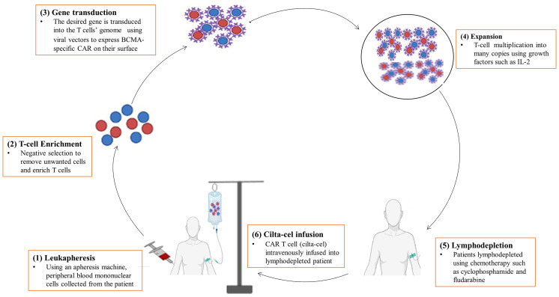
Solution Description
Abebe (2022)

Slide 7
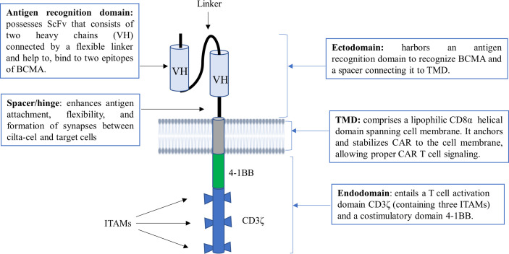
Solution Description
Abebe (2022)

Slide 8
Verification and Validation Studies
Carpenter et al (2013): Verified BCMA as suitable target for CAR-expressing T-cells
Recognize and kill primary MM cells in vitro
Berdeja et al (2021): Validated with phase 1b/2 open-label study
113 enrolled patients between 2018 and 2019
Median of 6 prior therapies
97% response rate
Grade 3-4 hematological adverse events common, grade 5 rare

Slide 9
Conclusion
Prominent example of cell engineered-product on the market
Promising treatment for relapsed/refractory MM patients
Near-term: Increase availability, decrease cost
Long-term: CAR-T as front-line therapy for cancer

Slide 10
References
Al Hamed, Rama et al. ‘Current Status of Autologous Stem Cell Transplantation for Multiple Myeloma’. Blood cancer journal 9.4 (2019): 44. Web.
Berdeja, Jesus G. et al. ‘Ciltacabtagene Autoleucel, a B-Cell Maturation Antigen-Directed Chimeric Antigen Receptor T-Cell Therapy in Patients with Relapsed or Refractory Multiple Myeloma (CARTITUDE-1): A Phase 1b/2 Open-Label Study’. Lancet 398.10297 (2021): 314–324. Web.
Brigle, K. & Rogers, B. Pathobiology and diagnosis of multiple myeloma. en. Semin. Oncol. Nurs. 33, 225–236 (Aug. 2017).
Carpenter, Robert O. et al. ‘B-Cell Maturation Antigen Is a Promising Target for Adoptive T-Cell Therapy of Multiple Myeloma’. Clinical cancer research: an official journal of the American Association for Cancer Research 19.8 (2013): 2048–2060. Web.
CARVYKTITM https://www.carvykti.com/
Chekol Abebe, Endeshaw et al. ‘Ciltacabtagene Autoleucel: The Second Anti-BCMA CAR T-Cell Therapeutic Armamentarium of Relapsed or Refractory Multiple Myeloma’. Frontiers in immunology 13 (2022): 991092. Web.
Fabrizio Esma, Marco Salvini, Rossella Troia, Mario Boccadoro, Alessandra Larocca & Chiara Pautasso (2017) Melphalan hydrochloride for the treatment of multiple myeloma, Expert Opinion on Pharmacotherapy, 18:11, 1127-1136, DOI: 10.1080/14656566.2017.1349102
Gandolfi, Sara et al. The Proteasome and Proteasome Inhibitors in Multiple Myeloma’. Cancer metastasis reviews 36.4 (2017): 561–584. Web.
Holstein, Sarah A., Philip L. McCarthy. ‘Immunomodulatory Drugs in Multiple Myeloma: Mechanisms of Action and Clinical Experience’. Drugs 77.5 (2017): 505–520. Web.
Immunomodulators and their Side Effects. American Cancer Society. Available at: https://www.cancer.org/treatment/treatments-and-side-effects/treatment- types/immunotherapy/immunomodulators.html#:~:text=Immunomodulators%20are%20a%20gro up%20of,proteins%20and%20turning%20up%20others. (Accessed: November 1, 2022).
Joshua, D. E., Bryant, C., Dix, C., Gibson, J. & Ho, J. Biology and therapy of multiple myeloma. en. Med. J. Aust. 210, 375–380 (May 2019).
Kazandjian, D. Multiple myeloma epidemiology and survival: A unique ma- lignancy. en. Semin. Oncol. 43, 676–681 (Dec. 2016).
Martin, Thomas et al. ‘Ciltacabtagene Autoleucel, an Anti-B-Cell Maturation Antigen Chimeric Antigen Receptor T-Cell Therapy, for Relapsed/Refractory Multiple Myeloma: CARTITUDE-1 2-Year Follow-Up’. Journal of clinical oncology: official journal of the American Society of Clinical Oncology (2022): JCO2200842. Web.
U.S. FDA Approves CARVYKTIα̈ (ciltacabtagene autoleucel), Janssen’s First Cell Therapy, a BCMA-Directed CAR-T Immunotherapy for the Treat- ment of Patients with Relapsed or Refractory Multiple Myeloma https: / / www . jnj . com / u - s - fda - approves -
carvykti - ciltacabtagene - autoleucel-janssens-first-cell-therapy-a-bcma-directed-car-t- immunotherapy-for-the-treatment-of-patients-with-relapsed-or- refractory-multiple-myeloma.
Vozella, F., Fazio, F., Lapietra, G., Petrucci, M. T., Martinelli, G., & Cerchione, C. (2021). Monoclonal antibodies in multiple myeloma. Panminerva Medica, 63(1), 21–27. doi:10.23736/S0031-0808.20.04149-X
Weisel, K., Martin, T., Krishnan, A., Jagannath, S., Londhe, A., Nair, S., ... Yong, K. (2022). Comparative efficacy of ciltacabtagene autoleucel in CARTITUDE-1 vs physician’s choice of therapy in the long-term follow-up of POLLUX, CASTOR, and EQUULEUS clinical trials for the treatment of patients with relapsed or refractory multiple myeloma. Clinical Drug Investigation, 42(1), 29–41. doi:10.1007/s40261-021-01100-y
Zhao, Wan-Hong et al. ‘A Phase 1, Open-Label Study of LCAR-B38M, a Chimeric Antigen Receptor T Cell Therapy Directed against B Cell Maturation Antigen, in Patients with Relapsed or Refractory Multiple Myeloma’. Journal of hematology & oncology 11.1 (2018): 141. Web.

